Slide 1



MySQL CONSTRAINTS
Sai Vardhan T

Slide 2
Introduction to SQL Constraints
SQL constraints are essentially rules that define the valid data allowed within your database tables.
They play a crucial role in maintaining data integrity and accuracy.
Constraints can be applied at the column or table level, depending on the specific rule you want to enforce.

Slide 3
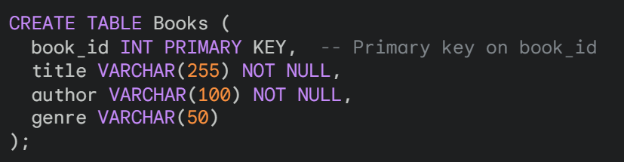
PRIMARY KEY
Primary Key (PK) constraint in SQL acts as a unique identifier for each row in a table. It enforces two key rules:
NOT NULL
UNIQUE

Slide 4
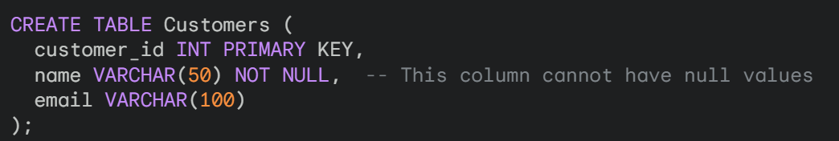
NOT NULL
This constraint prevents null values (empty values) from being stored in a specific column.
In this example, the name column cannot be empty when inserting data into the Customers table.

Slide 5
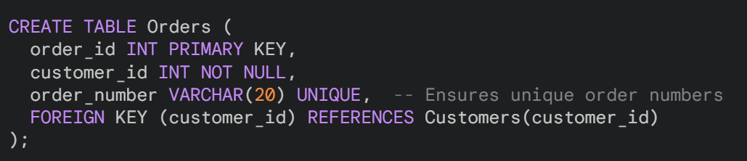
UNIQUE
This constraint ensures all values within a column are distinct. No two rows can have the same value in that column.
Here, the order_number column enforces uniqueness, guaranteeing no duplicate order numbers exist in the Orders table.

Slide 6
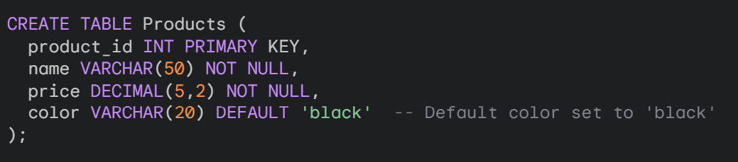
DEFAULT
The DEFAULT constraint in SQL is used to specify a default value for a column in a table.
This value is automatically inserted whenever a new record is added and no value is explicitly provided for that particular column.
In this example, the color column has a DEFAULT constraint set to "black".

Slide 7
WORKING WITH AUTO-INCREMENT
Auto increment is a feature available in most database systems that automatically generates a unique numeric value for a designated column whenever a new record is inserted into a table.
This simplifies assigning unique identifiers and streamlines data management. Here's an example demonstrating auto increment in action:
Scenario:
We want to create a table to store information about employees in a company. The table should include an ID for each employee, their name, and department.

Slide 8
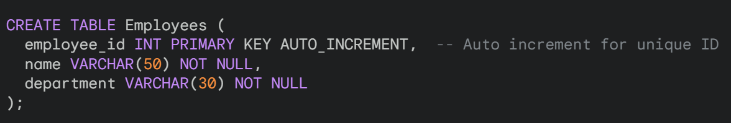

WORKING WITH AUTO-INCREMENT
Steps:
Create the Table with Auto Increment:
Inserting Data (No need to specify ID):

Slide 9
CHECK CONSTRAINT
Check constraints in SQL act as data validation rules enforced at the column or table level.
They ensure that the data inserted into your tables adheres to specific conditions beyond basic data type restrictions.
How Check Constraints Work:
You define a logical expression (predicate) that evaluates to true or false for each row being inserted or updated.

Slide 10
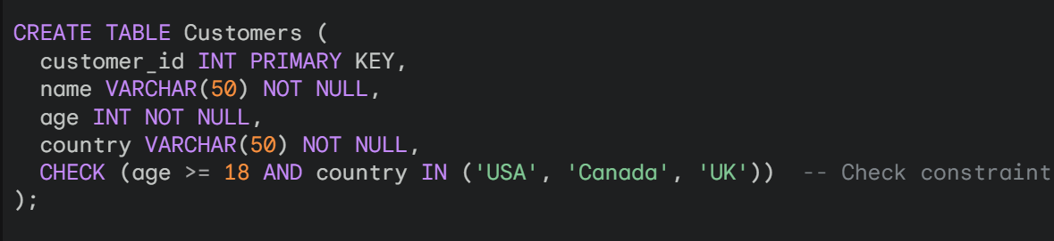
CHECK CONSTRAINT
Example:
Imagine you have a Customers table with columns for age and country. You want to ensure customers are at least 18 years old and reside in a supported country.
In this example:
The CHECK constraint defines a condition that both age must be greater than or equal to 18 and country must be one of the listed values.
Any attempt to insert a customer record that violates this condition (e.g., age 17 or unsupported country) will trigger an error.

Slide 11
NULL & NOT NULL
NULL Values:
In databases, a NULL value represents the absence of a known data value. It's often used to indicate that a data point is missing or unknown.
NOT NULL Constraint:
The NOT NULL constraint is a data integrity rule enforced at the column level in a table. It ensures that a column cannot contain NULL values. This means every record in that column must have a valid data entry.

Slide 12
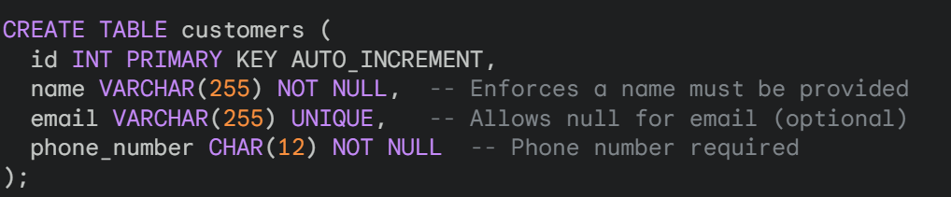
EXAMPLE FOR NULL & NOT NULL (1)
name and phone_number have NOT NULL constraints, so every customer must have a name and phone number.
email allows NULL values, indicating it's optional.

Slide 13
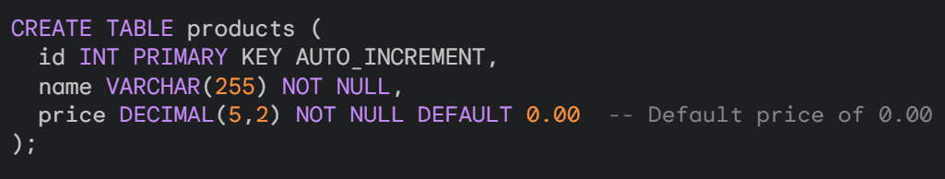
EXAMPLE FOR NULL & NOT NULL (2)
You can also define a default value to be inserted automatically if no value is provided during data insertion, even with a NOT NULL constraint.
Here, the price column has a NOT NULL constraint but also sets a default value of 0.00 if no price is provided during insertion.

Slide 14
RELATIONSHIPS IN DBMS
In relational databases, relationships represent the connections between different tables.
These connections establish how data in one table relates to data in another.
They are crucial for organizing your database efficiently and avoiding data redundancy.
One-to-One ( 1:1 )
One-to-Many ( 1:M )
Many-to-Many ( M:M )

Slide 15
ONE - TO- ONE (1:1)
In this relationship, a single record in one table can be associated with only one record in another table, and vice versa. It's not very common as it can often be modeled differently.
Example:
Imagine a Users table and a LoginCredentials table. In a perfect 1:1 scenario, each user would have only one set of login credentials, and each credential set would belong to just one user. However, this structure might not be ideal for security reasons (storing credentials with user data).

Slide 16
ONE – TO – MANY (1:M)
This is the most common type of relationship. A single record in one table (the "one" side) can be linked to multiple records in another table (the "many" side).
Example:
Consider a Customers table and an Orders table. One customer can place many orders, but each order belongs to only one customer. The foreign key in the Orders table (referencing the primary key in Customers) establishes this connection.

Slide 17
MANY – TO – MANY (M:M)
In this relationship, multiple records in one table can be associated with multiple records in another table. A classic many-to-many scenario requires an additional table to act as an intermediary and resolve the relationship.
Example:
Imagine a Courses table and a Students table. A student can enroll in many courses, and a course can have many students enrolled. An intermediary table, Course_Enrollment, can link courses and students with foreign keys, recording which students are enrolled in which courses.

Slide 18
FOREIGN KEY
Foreign Key (FK) constraint in SQL acts as a crucial element in establishing relationships between tables.
It essentially references the primary key of another table, ensuring data consistency and reducing redundancy.
Concept:
Imagine two tables:
Customers table with columns like customer_id (primary key), name, email.
Orders table with columns like order_id (primary key), customer_id (foreign key), order_date, total_amount.

Slide 19
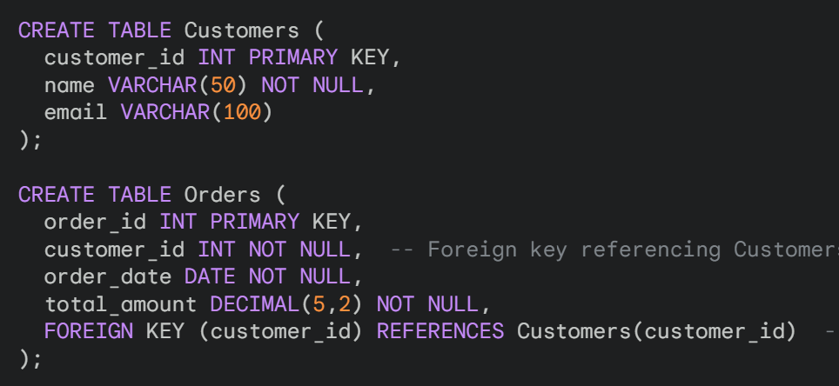
FOREIGN KEY
The customer_id in the Orders table is a foreign key. It references the customer_id (primary key) in the Customers table.
This creates a one-to-many relationship:

Slide 20
ALTER CONSTRAINTS
The ALTER TABLE statement offers ways to manage constraints after they've been created.
Drop the existing constraint:
Use the ALTER TABLE statement with the DROP CONSTRAINT clause to remove the constraint you want to modify.

